Slide 1



Blackpool Music Service
Online Guitar lessons
Sarah Hallam
Week 2

Slide 2
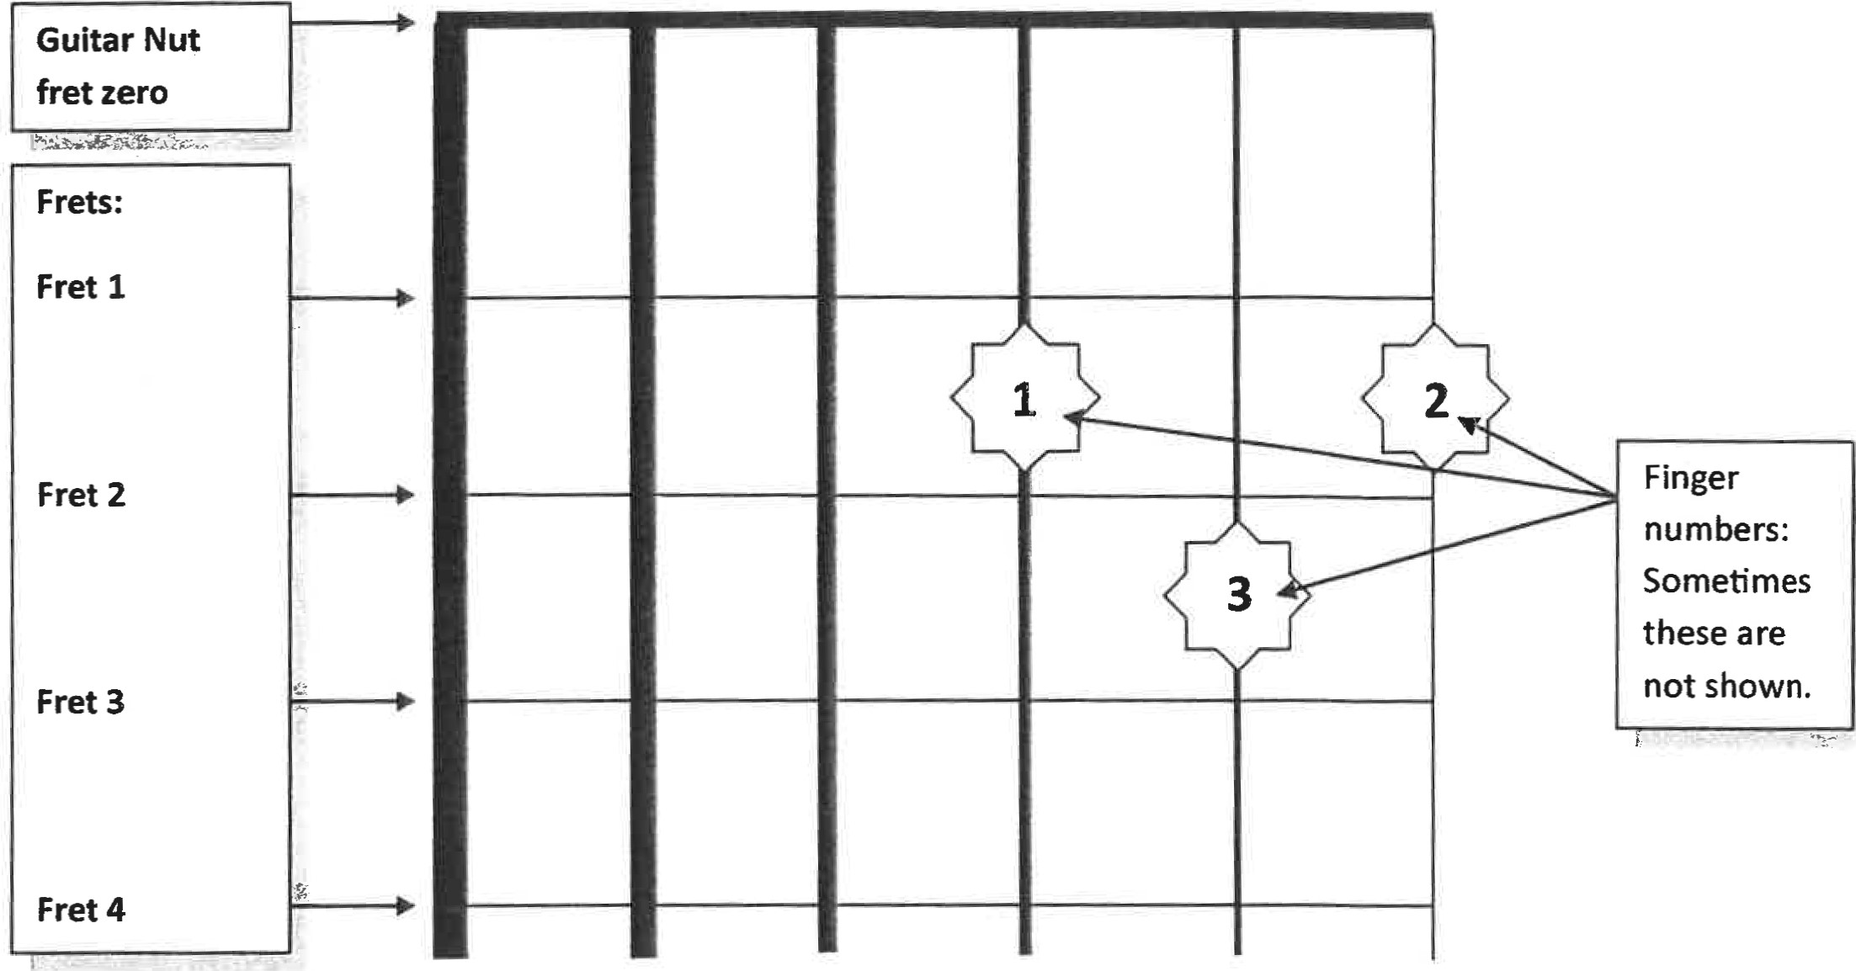
D Chord
To play the “D Chord” only strum strings 1,2,3 and 4.
Use to tip of your fingers to press down on the strings. If the sound is dull, make sure your fingers aren’t catching on the other strings.
Check each string from 4-1 to make sure you get a clean crisp sound, if not try figure out why the sound Is dull, until you get a clean sounding chord.
No.
6
5
4
3
2
1
String
Eddie Ate Dynamite Good Bye Eddie

Slide 3
Easy G Chord (1 finger only)
Place your finger on the 3rd fret on the high E string (string 1)
strum from the 4th sting down, 6 times.
6th 5th 4th 3rd 2nd 1st

Slide 4
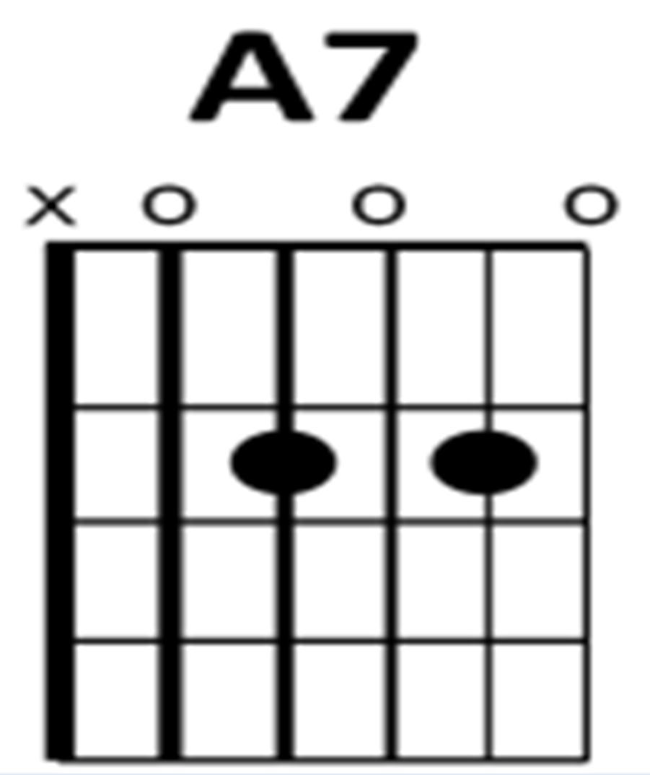
A7 Chord
Place your fingers on the 4th and 2nd strings on the 2nd fret.
Strum from the 5th string down. Strum 6 times.

Slide 5
Rockin All Over The World!
https://www.youtube.com/watch?v=Yw_sJifUYgM
Click the link to open the song and play along!!! (“ctrl” + left click)

